Slide 1

Liposomal solution containing DGLA, Equol and
Carnitine for the treatment of androgenetic alopecia

Slide 2
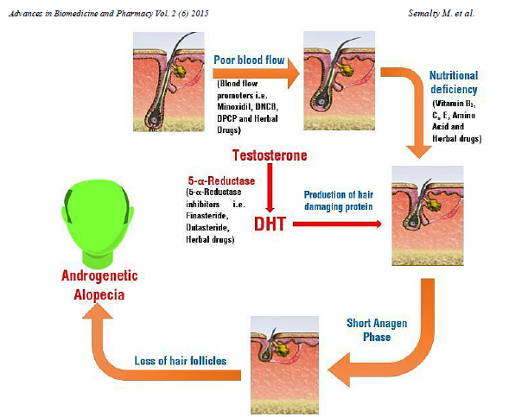
MECHANISMS AT THE BASIS OF ANDROGENETIC ALOPECIA

Slide 3
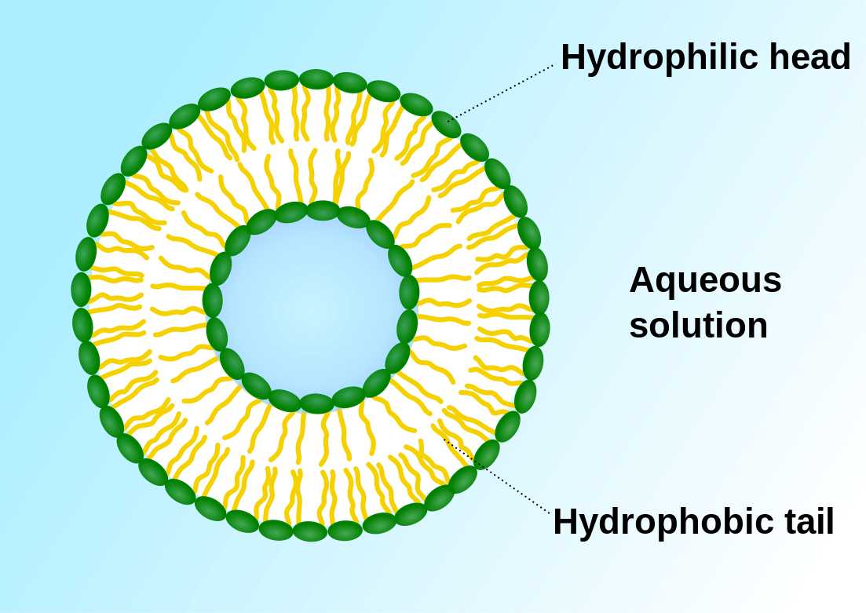
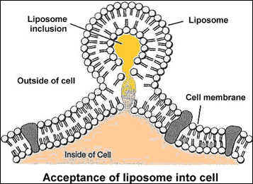
WHAT ARE LIPOSOMES?
  The liposome is a closed phospholipid vesicle consisting of one or more double layers of phospholipids, separated by aqueous compartments. The size of these vesicles can generally range from 25 nm to 1 μm in diameter.
  Liposomes are used successfully as systems for the delivery of many molecules. The lipid double layer of liposomes, merging with cell membranes, allows the release of its contents.
  Enhanced Delivery of Retinoic Acid to Skin by Cationic Liposomes. Shuji KITAGAWA and Masatoshi KASAMAKIa, Chem. Pharm. Bull. 54(2) 242—244 (2006) Vol. 54, No. 2

Slide 4
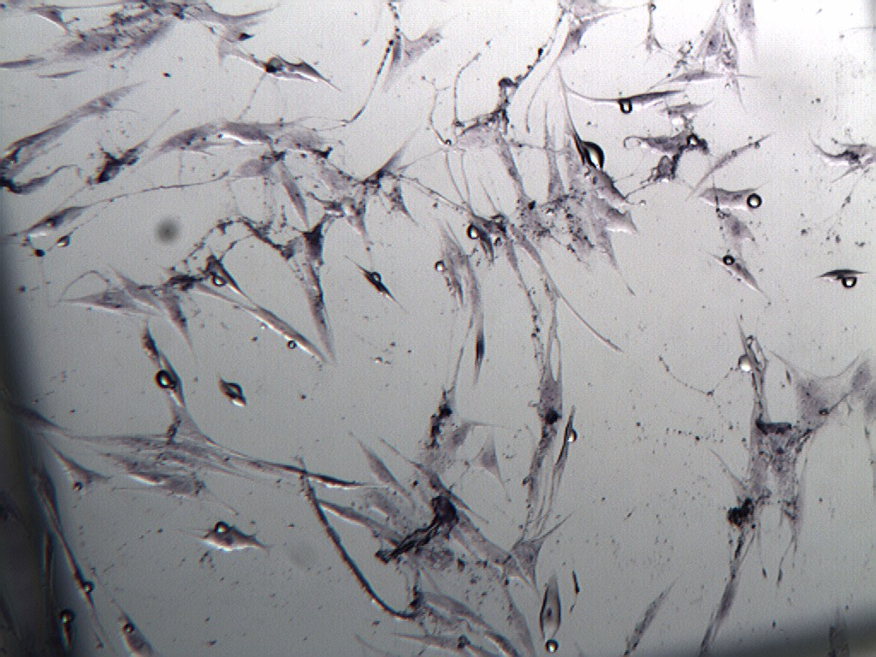
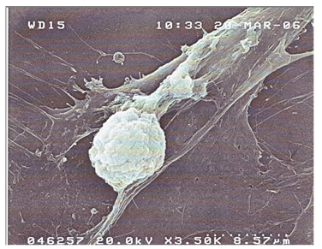
LIPOSOMe-ENDOTELIAL CELLS
Endothelial cells in culture with liposomes under the electron microscope 10000 X

Slide 5
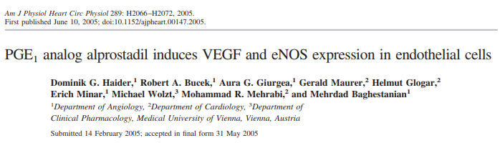
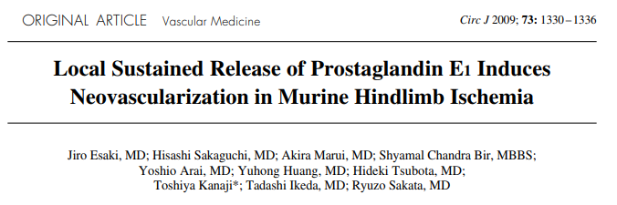
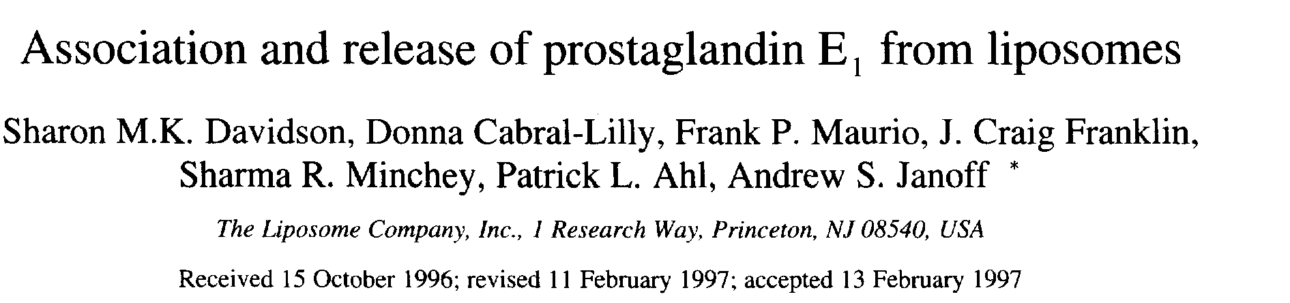
Prostaglandin E1 (PGE1) is a known microcirculatory activator, and already in the 1990s it was incorporated into liposomes in order to prolong its plasma half-life
Increases vasodilation
Increases capillary elasticity
Stimulates the proliferation of endothelial cells

Slide 6
In a research carried out at the S. Antonio Clinic in Cagliari it was observed that if a solution containing Liposomes loaded with PGE1 was applied on skin in the vicinity of skin ulcers of diabetic origin there was hair growth.
On the basis of these results, a research began to develop a formula containing a precursor of PGE1 transported in liposomes, which in combination with other ingredients, was able to stimulate hair growth and slow down hair fall.

Slide 7
Ingredients OF Hair loss LOTION

Slide 8
DGLA→ Precursor of PGE1, known microcirculatory activator
The diomo-gamma-linolenic acid, abbreviated DGLA, is a polyunsaturated fatty acid that is converted into PGE1 by the cyclo-oxygenase 1
Differential metabolism of dihomo-gamma-linolenic acid (DGLA) and arachidonic acid by cyclo-oxygenase-1 and cyclo-oxygenase-2: implications for cellular synthesis of prostaglandin E1 and prostaglandin E2. Levin G et al. Biochem J. 2002 Jul 15;365(Pt 2):489-96.

Slide 9
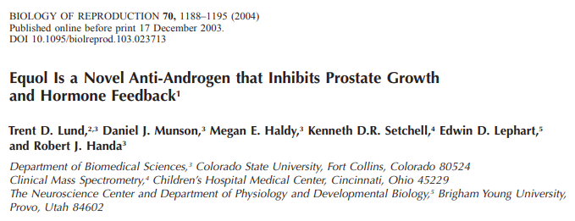
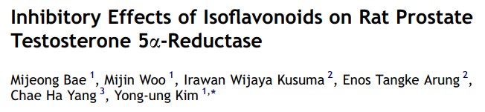
Equol → It inhibits DHT formation, which causes follicle atrophy
Equol is an isoflavone able to block 5-α-reductase and antagonize the action of dihydrotestosterone (DHT), responsible for the atrophy of hair follicles.

Slide 10
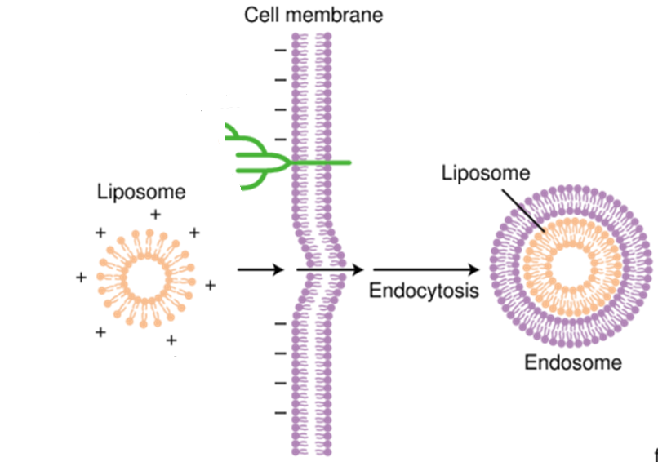
Propionyl-L-Carnitine → energizing action
The best known activity of Carnitine is its role as a transporter of long chain fatty acids in the mitochondria of the cell, producing energy thanks to the beta-oxidation of fatty acids.
Hollis Jr, Vincent W., and Melvin Blecher. "Carnitine Stimulated Transport of the Intermediates of Long Chain Fatty Acid β Oxidation in Liver and Heart Mitochondria." Proceedings of the Society for Experimental Biology and Medicine 125.4 (1967): 1201-1206.
Propionyl-L-carnitine also gives positive charge to liposomes, improving their adhesion to the scalp.
Qin, Geng, et al. "Charge influence of liposome on transdermal delivery efficacy." Soft Matter 9.23 (2013): 5649-5656.
Fang, Jia-You, Tsong-Long Hwang, and Yen-Ling Huang. "Liposomes as vehicles for enhancing drug delivery via skin routes." Current Nanoscience 2.1 (2006): 55-70.

Slide 11
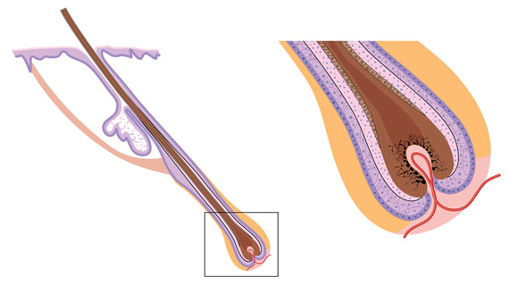
In summary
Cationic liposomes with a diameter of less than 200 nm carry molecules into the hair follicles, ensuring local action.
DGLA is metabolized into PGE1 by the cyclo-oxygenase and acts on endothelial cells, improving microcirculation and consequently the oxygenation of the hair bulbs and their metabolic supply.
Equol counteracts the action of DHT, preventing the atrophy of hair follicles.
Propionyl-L-carnitine has an energizing action by acting on the beta oxidation of lipid chains.
Liposomi
Liposomi

Slide 12






SPECIFICS OF THE LOTIONS
2 specific formulas for male and female
Environments for contamination, temperature and controlled humidity
Patented production technology to obtain liposomes of suitable size and charge
Quality guaranteed by careful analytical checks on each production lot
Reproducibility ensured only by a validated industrial production
GOOD TOLERABILITY AND EFFECTIVENESS OF THE PRODUCT

Slide 13
STUDY DESIGN: ANDROGENETIC ALOPECIA
Investigational Product: Liposomal Lotion
Indication: Prevention of hair loss
Patients: 30 male 30 female
Duration of treatment: 6 months
Applications: 1 ml of lotion a day on the scalp
Parameters evaluated at T0-T1-T3 and T6 months:
Phototrichogram (total hair number,% Anagen,% Telogen)
Number of hair lost during washing (Wash test)
Tensile strength (Pull test)
Hair diameter (Electron microscopy)
Digital images of the head
Clinical evaluation of the scalp
6 month evaluation questionnaire
Notes:
The aim of the study is to evaluate the in vivo efficacy of two lotions in preventing the hair loss, one for males and another for females.
Population:
- 30 males, 18-50 years old, suffering from alopecia in stages II-IV of the Norwood-Hamilton scale.
- 30 females, 30-60 years old, suffering from alopecia in stages I-II of the Ludwig scale.
Description of
Intervention:
The aim of the study is to evaluate the in vivo efficacy of two topical lotions as a coadjutant treatment in preventing the hair loss and for strengthening and reinvigorating the hair.
The following evaluations are performed at the baseline, after 1, 3 and 6 months of lotion application:
- phototrichogram;
- resistance of the hair to traction (by means of pull test);
- number of hair lost during the washing (by means of wash test);
- objective dermatological evaluation of the scalp and the tolerability;
- digital images of the head;
- diameter of hair (Scanning Electron Microscope).
Liposomi a base di Dihomo-gamma-linolenico acido, Equolo e Propionil-L-carnitina HCl e lozione alopecia uomo e donna (dispersione liposomiale)

Slide 14
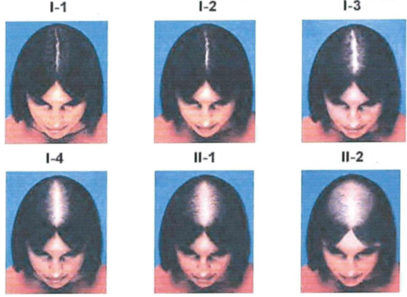
CHARACTERISTICS OF THE SUBJECTS
^{MALE}
^{FEMALE}
18-55 years old
Androgenetic alopecia (stage II-IV of the Norwood-Hamilton scale)
30-60 years old
Androgenetic alopecia (stage I-II Ludwig scale)

Slide 15
Results
Phototrichogram: the percentage of hair in Anagen increases significantly (after 1 month of treatment in females, p <0.0001, and after 3 months, p <0.01, of treatment in males), while the percentage of hair in Telogen decreases.
Wash Test: after one month of treatment hair loss decreases significantly in both males (p <0.001) and females (p <0.0001).
Pull test: the hair becomes significantly more resistant after 1 month of treatment in females (p <0.0001), and after 3 months of treatment in males (p <0.001).
The diameter of the hair does not vary significantly.
Lotions are well tolerated by patients. No scalp alteration has been reported.

Slide 16
patients FEEDBACK : EVALUATION QUESTIONNAIRE AFTER 6 MONTHS
^{MALE}
Reduce hair loss
Thicker hair
Stronger hair
More volume to the hair
Improve scalp conditions
Healthier hair
Easy to absorb
Fragrance pleasantess
Product on the whole
^{FEMALE}
Reduce hair loss
Thicker hair
Stronger hair
More volume to the hair
Improve scalp conditions
Healthier hair
Easy to absorb
Fragrance pleasantess
Product on the whole
CONGRESSO S.I.TRI, NAPOLI 2018

Slide 17
IMAGES
^{MALE}
^{FEMALE}
Baseline
1 Month
baseline
1 month
3 Months
6 months
3 months
6 months
CONGRESSO S.I.TRI, NAPOLI 2018

Slide 18
CONCLUSION
The lotions promotes hair growth (the percentage of hair in Anagen increases while the percentage of hair in Telogen decreases).
The lotions slows down hair loss.
The hair becomes more resistant.
The diameter of the hair does not change.
The lotions are well tolerated by patients.
Patients are satisfied with the lotions and claim that the lotions reduce hair loss and reinforce hair (thicker and more voluminous).
The lotions are well tolerated, easy to absorb and have a pleasant fragrance.

